Slide 1
What is family?
Workshop 1
Family Law
Winter 2022

Slide 2
Activity
Locate 2 pieces of paper and a pen/ pencil
Imagine that you are working for a marketing company. You want to advertise your products to Australian families. Draw an image that captures the ‘Australian family’. (3 minutes)
On the other piece of paper, draw ‘your’ family (3 minutes)
Introduce your family to another student (5 mins each, 10 mins in all)

Slide 3
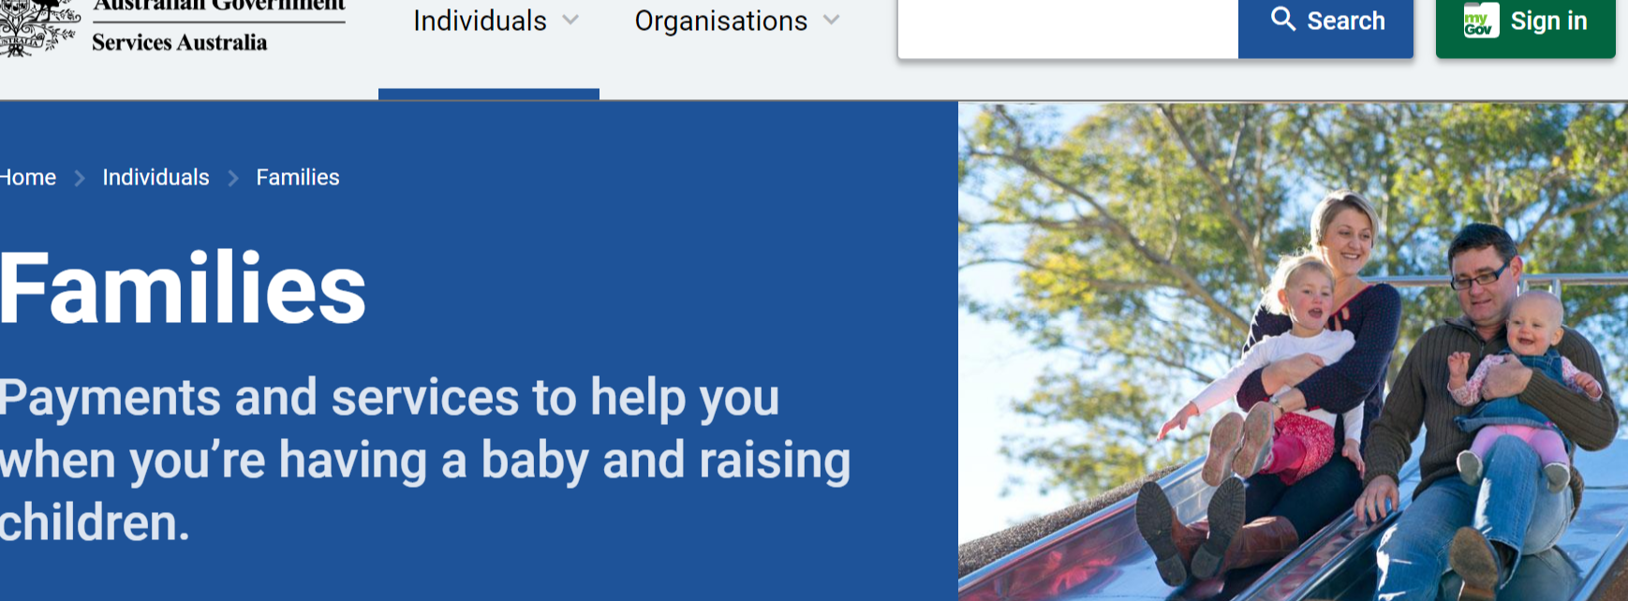



Online images of ‘Australian families’

Slide 4
Core elements of these representations of Australian family
Intimate (sexual) relationship
Children
Household settings
Couples
Happy
Others …

Slide 5
What we know about Australian families
https://aifs.gov.au/PUBLICATIONS/MODERN-AUSTRALIAN-FAMILY
http://theconversation.com/mum-dad-and-two-kids-no-longer-the-norm-in-the-changing-australian-family-88014
What were some of the differences between your own family, and those of others?

Slide 6
Reflection
Why do reflective practice
In life?
In law?
In family law?
What is it?
Dear diary …?
Identifying your feelings/ emotions (not your thoughts)
Identifying the needs under the emotions
How?
See guided questions in assessment section

Slide 7
Pause to consider
How are you ‘feeling’ right now? Can you name it?
Brainstorm a list of all the words for feelings. How many can you think of?
What human ‘need’ or ‘value’ do you think underpins that feeling?
Brainstorm a list of needs and values. How many can you think of?
Do you think others around you are feeling the same things? What might be the different feelings of those in the room?
Even if they are the same, do you think that there is the same underpinning need? What might be some other needs/ values held by other students in the room?
Workshop activity #2
Reflect on the ‘what is family activity’ – how it might have made you ‘feel’ – what were your underlying needs/ values - and write it up while fresh!

